Slide 1

Removing Stripe Noise from a Pushbroom Satellite Sensor Image DSA0203-computer Vision With Open Cv
Presented by:
Sudharsan.D-(192524063)
Guidanced by:
Dr. Narenthirakumar

Slide 2


INTRODUCTION
What is Stripe Noise?
Stripe noise appears as unwanted horizontal or vertical lines in satellite images.
It is caused by differences in the response of detector elements in pushbroom sensors.
This noise reduces image quality and affects image interpretation.
Objective
Detect and remove stripe noise.
Improve image quality while preserving important details.

Slide 3

Problem Statement
Problem
Pushbroom satellite sensors often produce striped patterns due to detector calibration errors.
These stripes make it difficult to analyze land cover, vegetation, roads, and water bodies.
Challenges
Preserve image details.
Remove only the stripe noise.
Avoid blurring the image.

Slide 4
Methodology
Steps Involved
Acquire the satellite image.
Detect stripe noise.
Apply preprocessing.
Use filtering techniques such as:
Median Filter
Fourier Transform
Wavelet Transform
Restore the cleaned image.
Evaluate image quality.

Slide 5
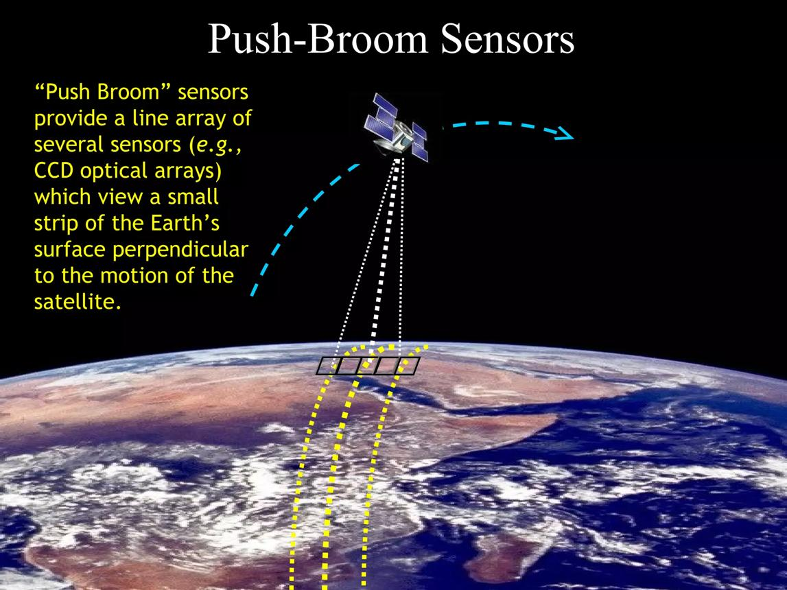
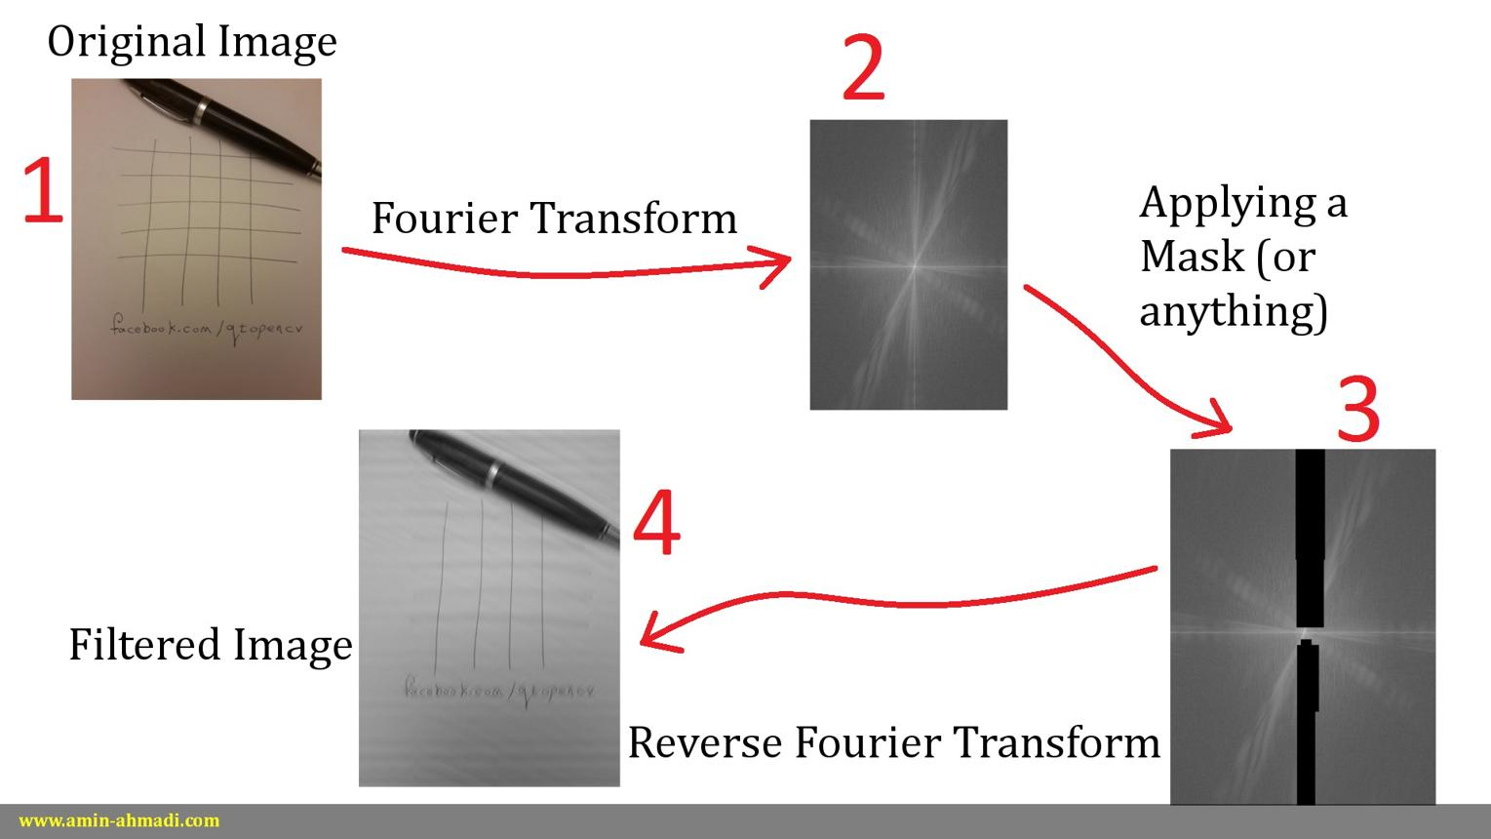
OUTPUT
1. Pushbroom Satellite Sensor
2. Fourier and Wavelet Techniques

Slide 6
Results and Benefits
Results
Stripe noise is significantly reduced.
Better image clarity.
Enhanced feature visibility.
Improved accuracy for image analysis.
Applications
Remote sensing
Agriculture monitoring
Urban planning
Disaster management
Environmental monitoring

Slide 7
Conclusion
Stripe noise reduces the quality of pushbroom satellite images.
Removing stripe noise improves image clarity and visual appearance.
Techniques like Fourier Transform, Wavelet Transform, and Median Filtering effectively reduce stripe noise.
Important image details and edges are preserved during the denoising process.
Enhanced images provide more accurate analysis for remote sensing applications.
Stripe noise removal supports applications such as agriculture, urban planning, environmental monitoring, and disaster management.

Slide 8


